Slide 1


AIMBIGATHON 2.0
DOTS

Slide 2



members
Magesh Sundar G
Lakshmi Narayanan R
Jaikrishna B
Shri Harri Priya R
Varsha Vigasini G
Gouthaman B

Slide 3

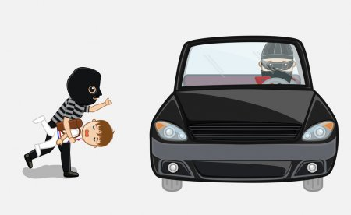
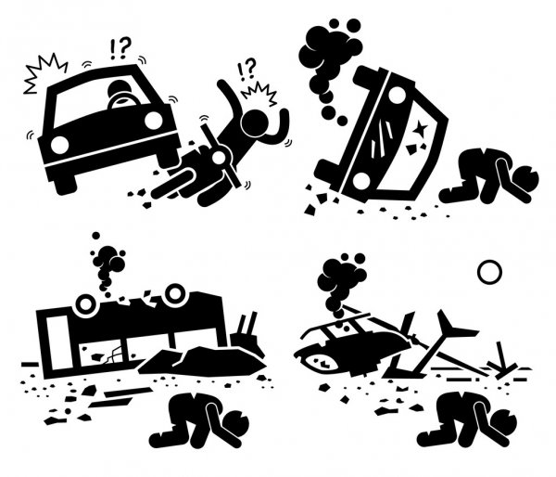
Problems
PROBLEMS
Drink and drive
Kidnapping
Accidents

Slide 4
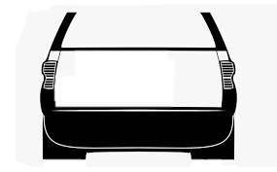
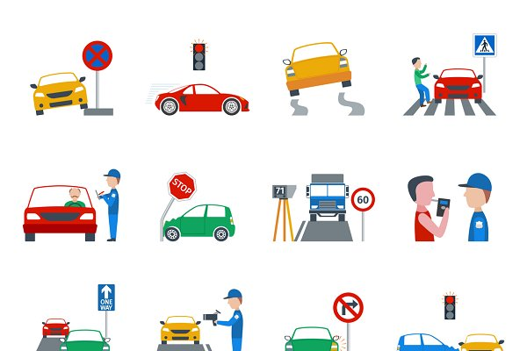
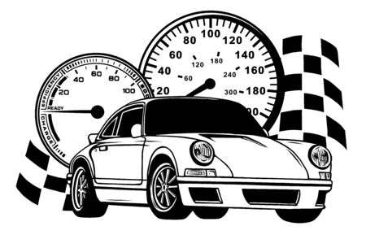

Problems
PROBLEMS
Fraud
Over speeding
Traffic violation

Slide 5
Abstract
This is a web application that analyses the number plate of a vehicle from an image or a video stream and determines data like type, make, model, colour and looks up in the database for any stolen, invalid or blacklisted registration numbers
We have established this with the help of a customized and self labelled dataset which is trained using yolo, a python library
We extract the number from the number plate of the vehicle and evaluate its other data elements like type, make, model, colour
We search for any stolen, invalid or blacklisted registration numbers in the other dataset that we have created
This web application can also determine the stated with live video stream as input

Slide 6


Technology Stack
Front-End
Back-End
AI
Python
TensorFlow 2 API
Tesseract
Open CV
Yolo v3 - Custom trained model
HTML
CSS
JS
BOOTSTRAP
Mongo DB
Flask
Python

Slide 7
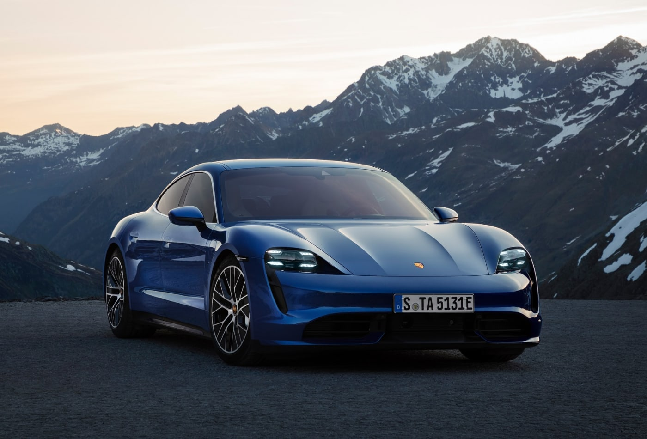
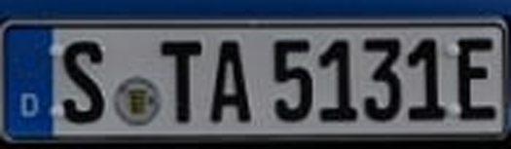
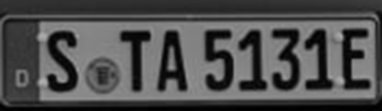

Description
This project uses YOLOv4 for training the model and to detect the license plate from the source given by the user
The license plate is detected and cropped by YOLOv4
The detected image is then dilated and converted into grey scale , we have applied Gaussian blur to smooth the image, then we proceed with Tesseract-5 OCR (Optical character recognition engine) . Further, Threshold is applied using Otsu’s method

Slide 8

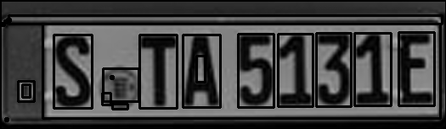
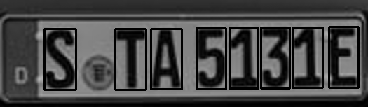

Description
We again dilate the image using OpenCV and apply contour, further we sort the contour and filter them and remove the unwanted contour
Next, to obtain the number and the letter in the number plate ,we segment the contour and using Tesseract-5 OCR ,we get the value of each contour

Slide 9
Description
Then we append all the values to obtain the license plate number in text format
That number from the license plate is used to evaluate its other data elements like type, make, model, color using the dataset, then we look up in the provided dataset for any blacklisted registration numbers
Then the result is displayed to the user

Slide 10
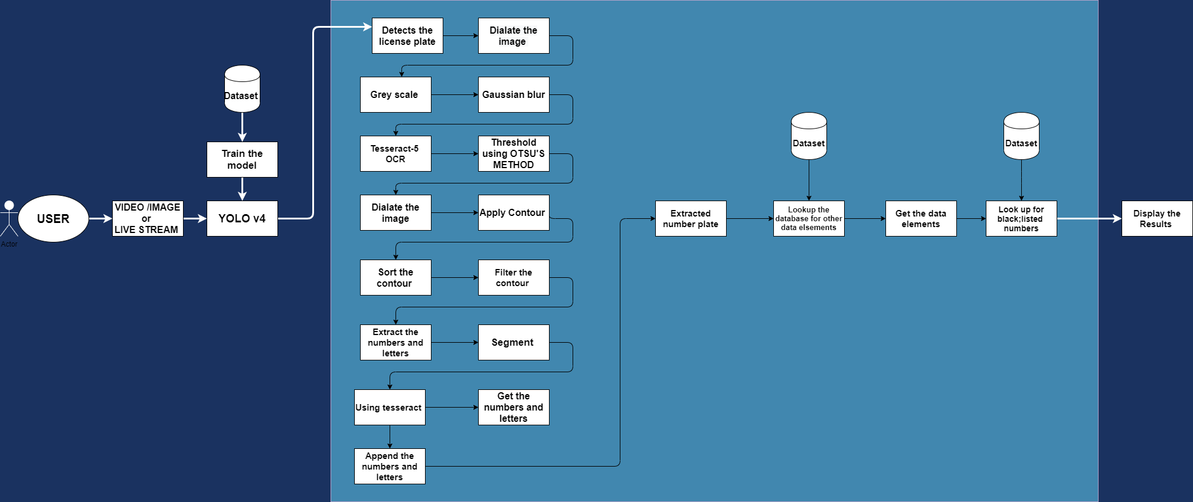
USE CASE DIAGRAM

Slide 11
Dependencies / Show stopper
Many accidents can be prevented when this project is implemented
Criminals who couldn’t be identified before can be identified now with the help of our project
Blacklisted vehicles can be identified
Traffic rules will be taken seriously after implementing this project as people and their vehicle can be tracked and identified
No external hardware needed

Slide 12

Thank You

